Slide 1
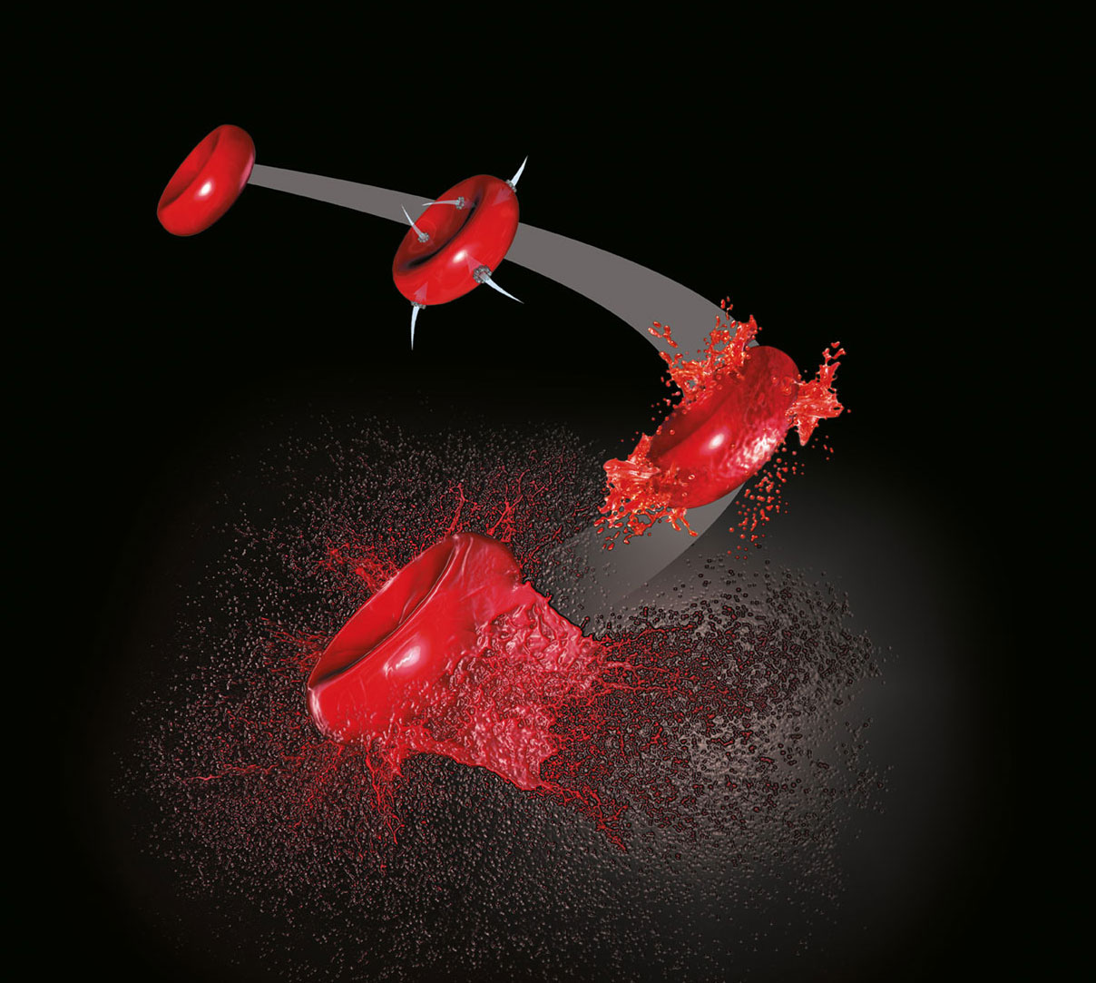
G6PD Deficiency and Induced Hemolysis
Diane Xue

Slide 2
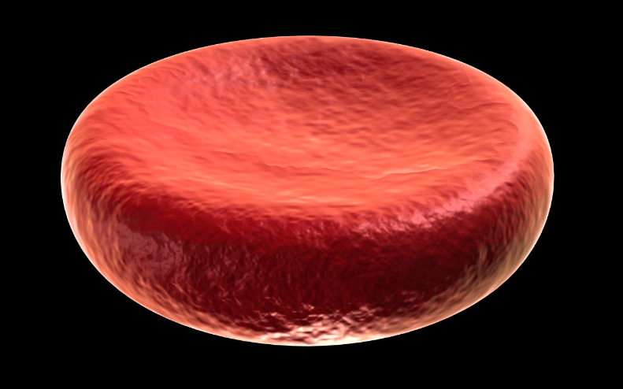
What is Hemolysis?
Red blood cells burst due to oxidative stress

Slide 3
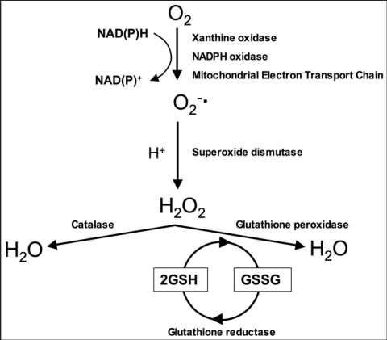
How do Cells Become Oxygen-Stressed?
G6PD
G6PD
No Build-up of Reactive Oxygen Species
G6PD deficiency → Build-up of reactive oxygen species

Slide 4
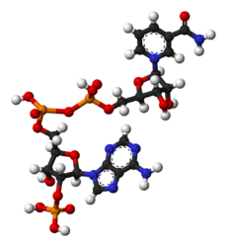
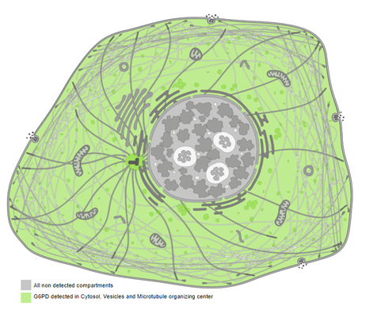
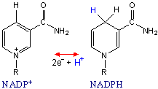
What is the function of normal G6PD?
NAD binding domain
C-terminal domain
X
Cellular Component
Cytoplasm
Molecular Functions
NADP Binding
Biological Process
NADP Metabolism

Slide 5
How well conserved is G6PD?
NAD binding domain
C-terminal domain
Humans
65- 240
242-540
Mouse
35-210
212-510
Zebrafish
43-218
220-518
Fruit fly
39-214
216-515
C. elegans
37-216
218-518
Yeast
15-196
198-494
Arabidopsis
35-221
223-510

Slide 6
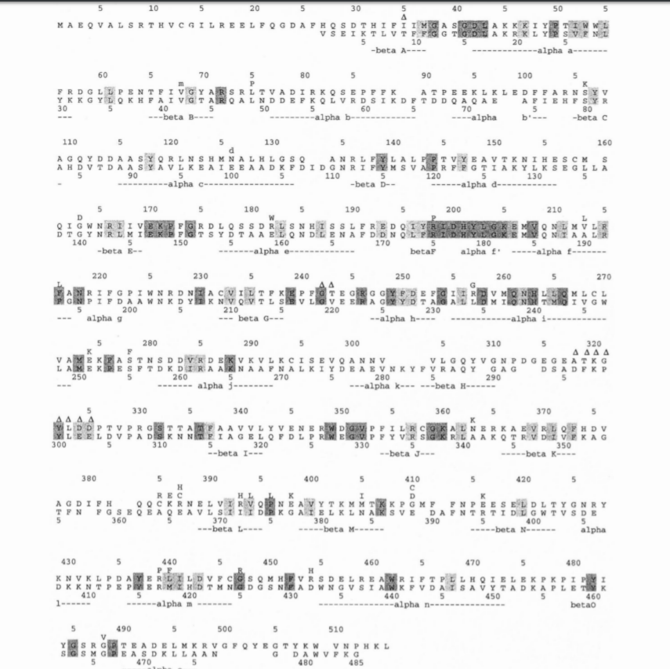
Which G6PD mutations cause deficient G6PD Protein?
Over 200 G6PD deficiency mutations have been sequenced

Slide 7
What Proteins Interact with G6PD?
NADP METABOLISM

Slide 8
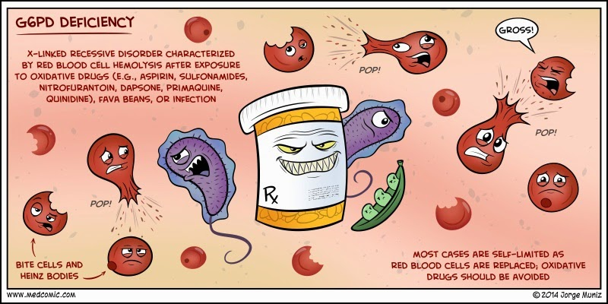
How is hemolysis triggered in G6PD-deficient cells?
External factors such as the antimalarial Primaquine

Slide 9
Can G6PD be upregulated?
** THIS STUDY WAS ONLY DONE ON MALES

Slide 10
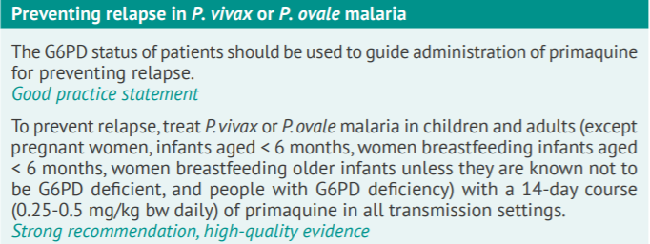
Goal: How does G6PD Methylation affect G6PD levels in Pregnant Females?
NAD binding domain
C-terminal domain

Slide 11
How does G6PD Methylation affect G6PD levels in Pregnant Females?
Aim 1:
Knockout conserved methylation sites of G6PD to identify methylation sites associated with normal levels of NADPH production in pregnant females.
Aim 2:
Identify a small molecule that affects methylation of G6PD and can be taken with Primaquine in pregnant females
Aim 3
Determine differences in protein interaction complexes required for NADP metabolism between methylated and unmethylated G6PD deficient pregnant zebrafish
Bisulfite DNA-Seq
Chemical Screen
Fluorescent Spot Test
Bisulfite DNA-Seq
ClustalOmega
CRISPR
Fluorescent Spot Test
CRISPR
Affinity pulldown
Mass Spectrometry

Slide 12
What Model Organism Will I Use?
Short generation times
Inexpensive
g6pd deficiency phenotype similar to Humans
Transparency allows visualization of hemolysis

Slide 13
Aim 1: Identify conserved methylation sites in G6PD normal pregnant zebrafish
Stage 1: Bisulfite-sequencing
Compare the methylation pattern in male, non-pregnant female, and pregnant zebrafish with normal and abnormal levels of NADPH:
P
P
NAD binding domain
C-terminal domain

Slide 14
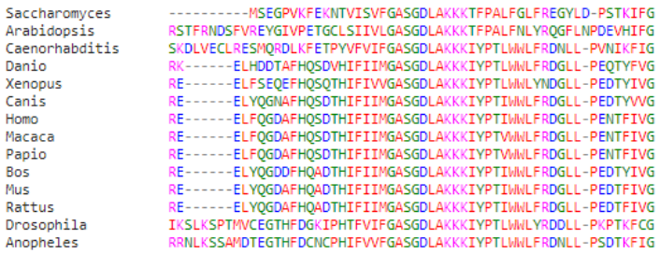
Aim 1: Identify conserved methylation sites in G6PD normal pregnant zebrafish
Stage 2: ClustalOmega
Determine if methylation sites are conserved across homologs:
NAD binding domain
C-terminal domain

Slide 15
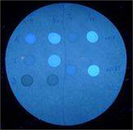
Aim 1: Identify conserved methylation sites in G6PD normal pregnant zebrafish
Stage 3: CRISPR and Fluorescent Spot Test
Knockout the most conserved methylation sites using CRISPR. Then, determine levels of NADP reduction using Fluorescent Spot Test
NAD binding domain
C-terminal domain
NADPH is naturally fluorescent

Slide 16
Aim 2: Identify a small molecule that affects G6PD methylation
Stage 1: Bisulfite Sequencing
Determine the methylation pattern in G6PD deficient pregnant zebrafish
P
NAD binding domain
C-terminal domain

Slide 17
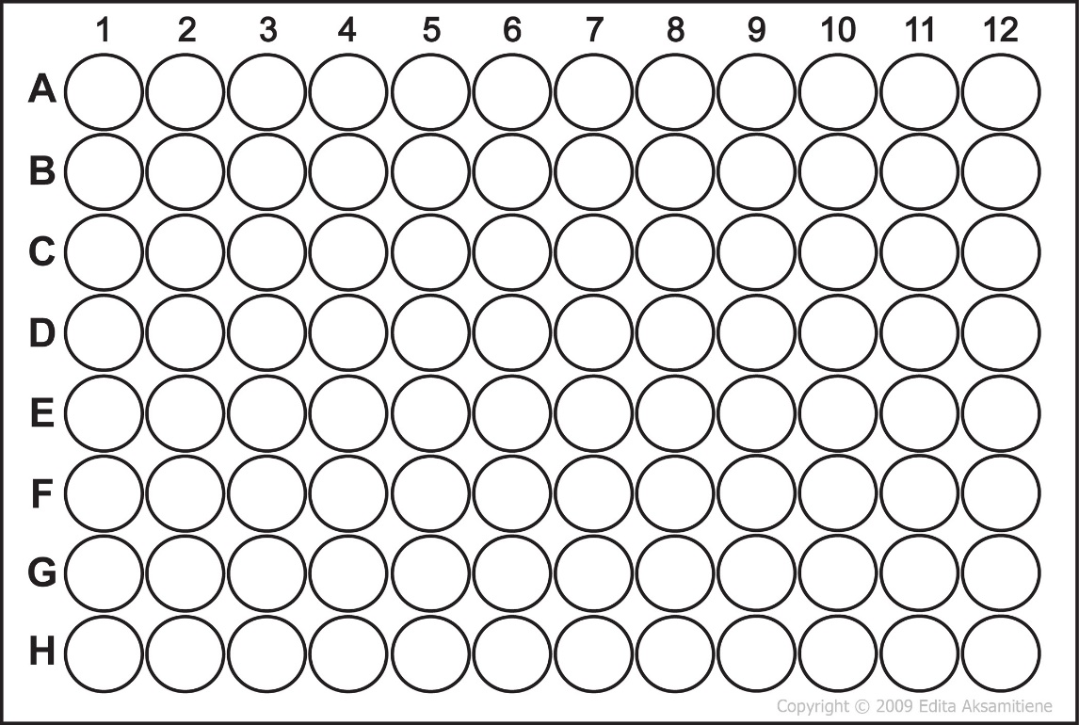
Aim 2: Identify a small molecule that affects G6PD methylation
Stage 2: Chemical Screen
Identify a small molecule that affects DNA methylation, destroys malaria parasite, and can be taken with Primaquine without causing hemolysis in G6PD deficient pregnant zebrafish.

Slide 18
Aim 2: Identify a small molecule that affects G6PD methylation
Stage 3: Fluorescent Spot Test and Bisulfite Sequencing II
Analyze NADPH levels and methylation changes
NAD binding domain
C-terminal domain

Slide 19
Aim 3: Determine differences in Protein-complexes associated with methylation changes
Stage 1: CRISPR
Knockout the conserved methylation sites of pregnant females using CRISPR
NAD binding domain
C-terminal domain
Control
NAD binding domain
C-terminal domain
Treatment

Slide 20
Aim 3: Determine differences in Protein-complexes associated with methylation changes
Stage 2: Tandem Affinity Purification and Pull Down

Slide 21
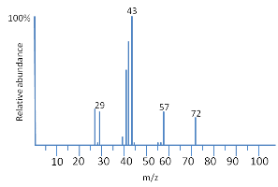
Aim 3: Determine differences in Protein-complexes associated with methylation changes
Stage 3: Mass Spectrometry

Slide 22
References
http://soliris.net/resources/images/consq-hemolysis-bg.jpg
https://openi.nlm.nih.gov/detailedresult.php?img=PMC2715191_omcl0101_0015_fig001&req=4
http://intranet.tdmu.edu.ua/data/kafedra/internal/chemistry/classes_stud/en/stomat/ptn/2/03.%20introduction%20to%20%20metabolism.%20investigation%20of%20aerobic%20and%20anaerobic%20oxidation%20of%20glucose.htm
http://geneticsandpublichealth.com/2016/06/05/glucose-6-phosphate-dehydrogenase-deficiency/
https://www.thediabetescouncil.com/diabetes-and-anemia-are-they-related/
https://www.researchgate.net/publication/236088554_Review_of_key_knowledge_gaps_in_glucose-6-phosphate_dehydrogenase_deficiency_detection_with_regard_to_the_safe_clinical_deployment_of_8-aminoquinoline_treatment_regimens_A_workshop_report

